Slide 1
Data ANALYTICS and visualisation(COM725)
Week 1: Introduction to THE MODULE AND TO Big Data

Slide 2
CONTENTS
01 | Introduction to Data Science Module
02 | Data Experts and Roles
03 | Introduction to Big Data
04 | 5 V’s of Big Data
05 | Data Structures
06 | Group Activity
07 | Use Cases
08 | Assessment Brief Discussion

Slide 3
Learning outcomes
At the end of this week, you will need to be able to
Understand the nature of data as it relates to business intelligence analytics
Understand the importance of data/information
Appreciate the value that visual analytics brings to business analytics
Understand how data science is important in the health sector
Understand the 5V’s of Big Data
Understand the requirements for your assessments

Slide 4
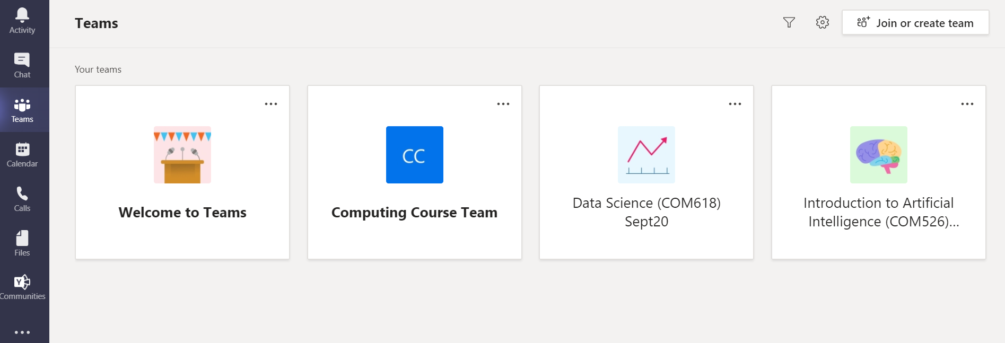
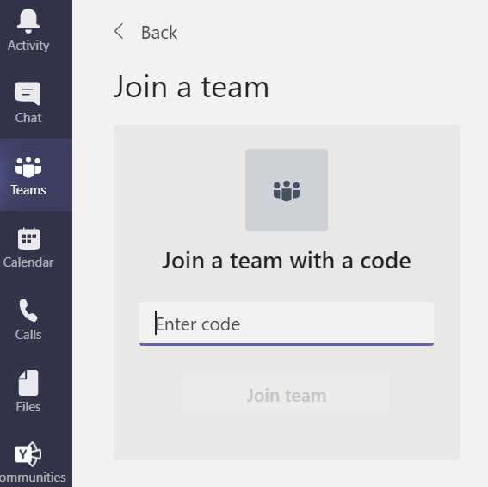
JOIN YOUR CLASSMATES ON MICROSOFT TEAMS

Slide 5


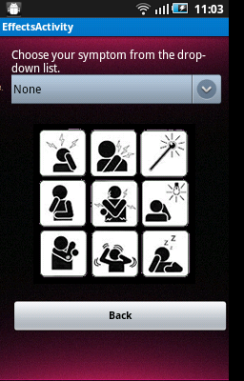
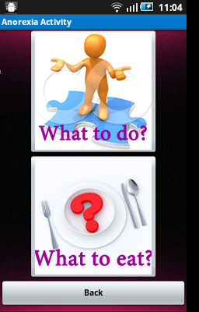
M-Health project - CANAdvice
Cancer Support & Advice (CANAdvice) application for home monitoring and symptom management of patients receiving chemotherapy treatment.

Slide 6
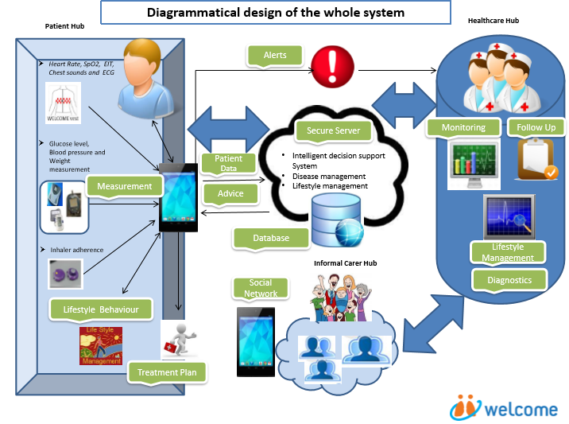
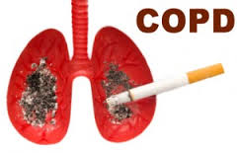
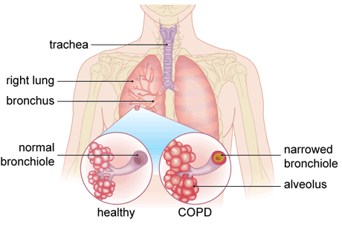
WELCOME EU Project
(Wearable Sensing and Smart Cloud Computing for Integrated Care to COPD Patients with Comorbidities)
By 2030: COPD will become the 3rd cause of mortality worldwide (WHO)
Most common factor leading to COPD is smoking. 10-25% of smokers develop COPD
Most common factor leading to COPD is smoking. 10-25% of smokers develop COPD
Other causes of COPD:
Air pollution
Passive smoking
Fumes and dust
Genetics
Weak immune system

Slide 7
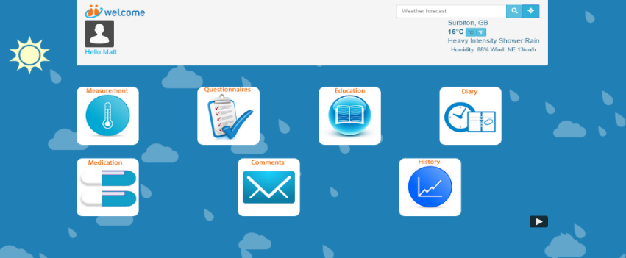
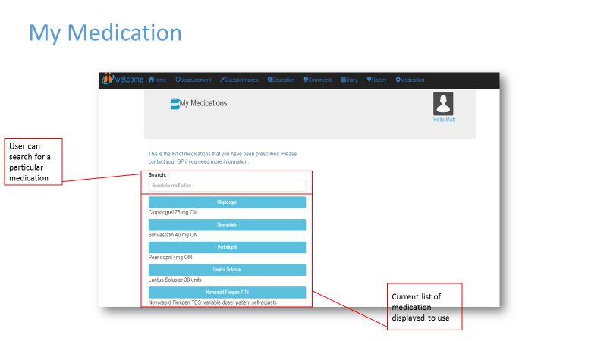
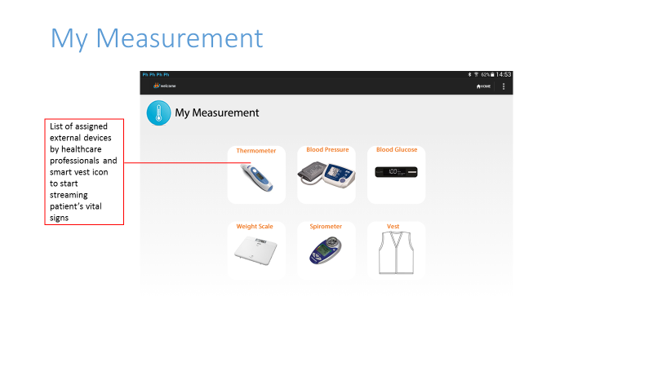
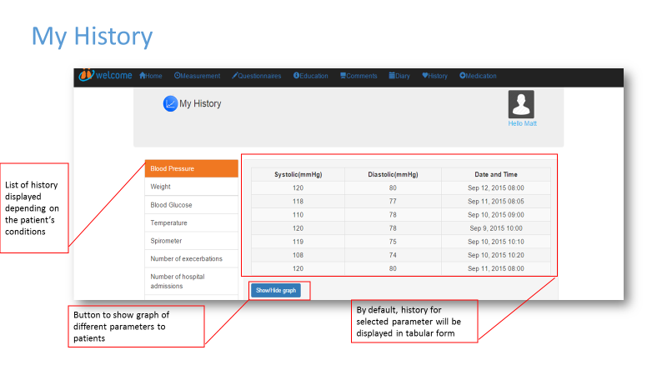
Solution: mHealth and AI
Early detection of COPD exacerbations based on previous patterns
Overall management of this long term condition
Maintaining adherence and lifestyle management enhanced by mHealth
Future Development:
Machine learning to improve risk prediction based on collected data

Slide 8
MALSEND PROJECT A Machine Learning Approach for a Predictive Employment Model
'Special Educational Needs and Disabilities (SEND)' refers to children who have learning problems or disabilities that make it harder for them to learn than most children of the same age.
A learning disability affects the way a person understands information and how they communicate.
Can machine learning be used to find a trend between learning disability and subject expertise
About 1.5 million people have a learning disability in the UK (NHS, 2018).
Up to 350,000 people have severe learning disabilities (NHS, 2018).
44% - 52% of autistic people may have a learning disability (NHS, 2018).

Slide 9
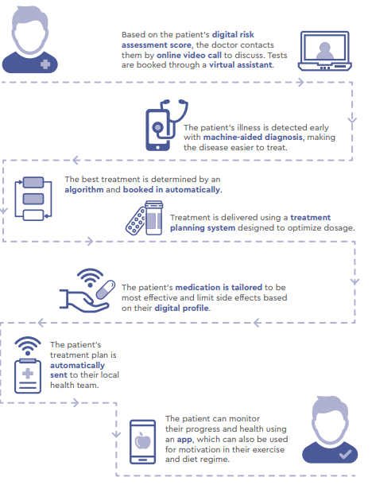
Benefits of AI in the health sector
Forecast population trends
Deliver more preventative care
Provide personalised treatments
Improve user experience
Improve productivity and reduce costs
(Report of the WISH Data Science and AI Forum 2018)

Slide 10
Applications of ai in health systems
AI has already been used successfully different stages of drug development
Detecting lung cancer or strokes based on CT scans
Assessing the risk of sudden cardiac death or other heart diseases based on electrocardiograms and cardiac MRI images
Classifying skin lesions in skin images
Finding indicators of diabetic retinopathy in eye images

Slide 11
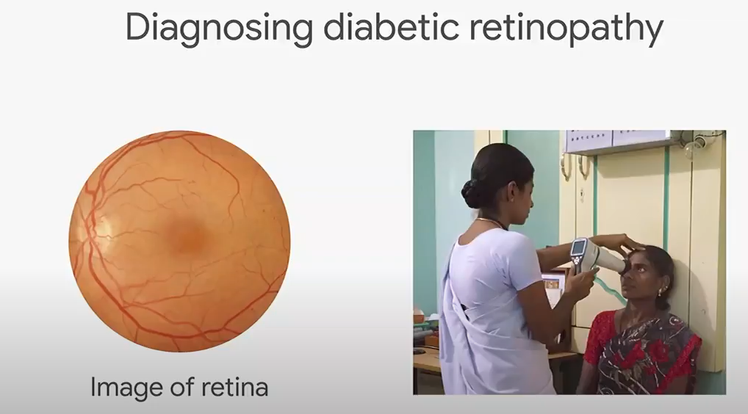
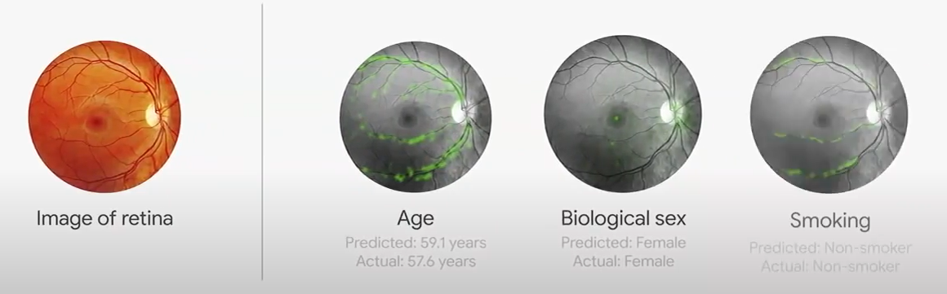
AI HEALTH applications
Artificial intelligence in diabetic retinopathy
Journal reference:
Lee, A.Y., et al. (2021) Multicenter, Head-to-Head, Real-World Validation Study of Seven Automated Artificial Intelligence Diabetic Retinopathy Screening Systems. Diabetes Care. doi.org/10.2337/dc20-1877.

Slide 12
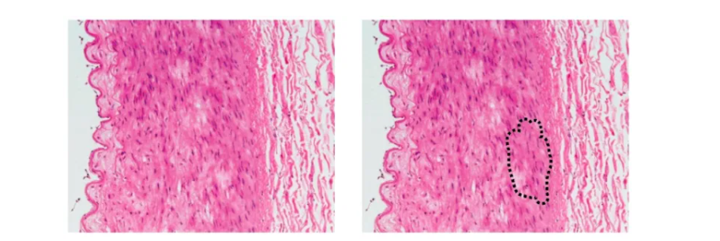
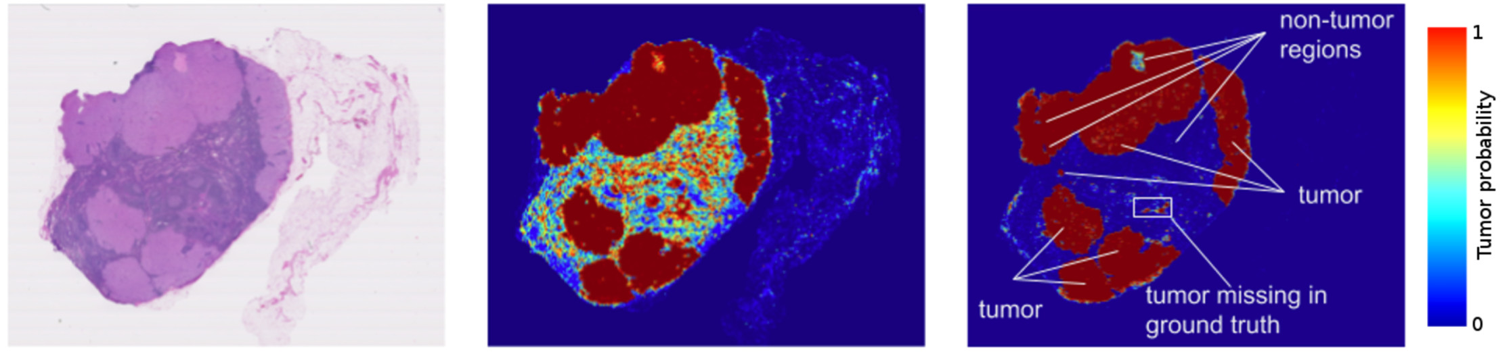
AI HEALTH applications
Computer Vision for Diagnosis of Cancer
Computer vision is a subdomain of AI that deals with how computers gain high level understanding through acquiring, processing and analysing digital images and video.
Chest radiographs to detect abnormal cell growth
These images were produced by Google's algorithm to detect breast cancer.
Daniel Greenfield, Harvard University, 2019

Slide 13
Introduction to the module
Data Management
Data Collection and Storage
Big Data Analysis Tools and Techniques
Data Preparation and Exploration
Data Visualisation
Experimentation and Prediction

Slide 14
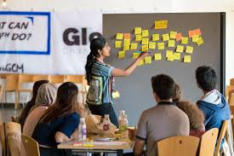
12 TEACHING WEEKS
LECTURE SESSIONS AND SEMINARS
WEEKLY CLASS ACTIVITIES
COLLABORATION &
TEAM WORK

Slide 15
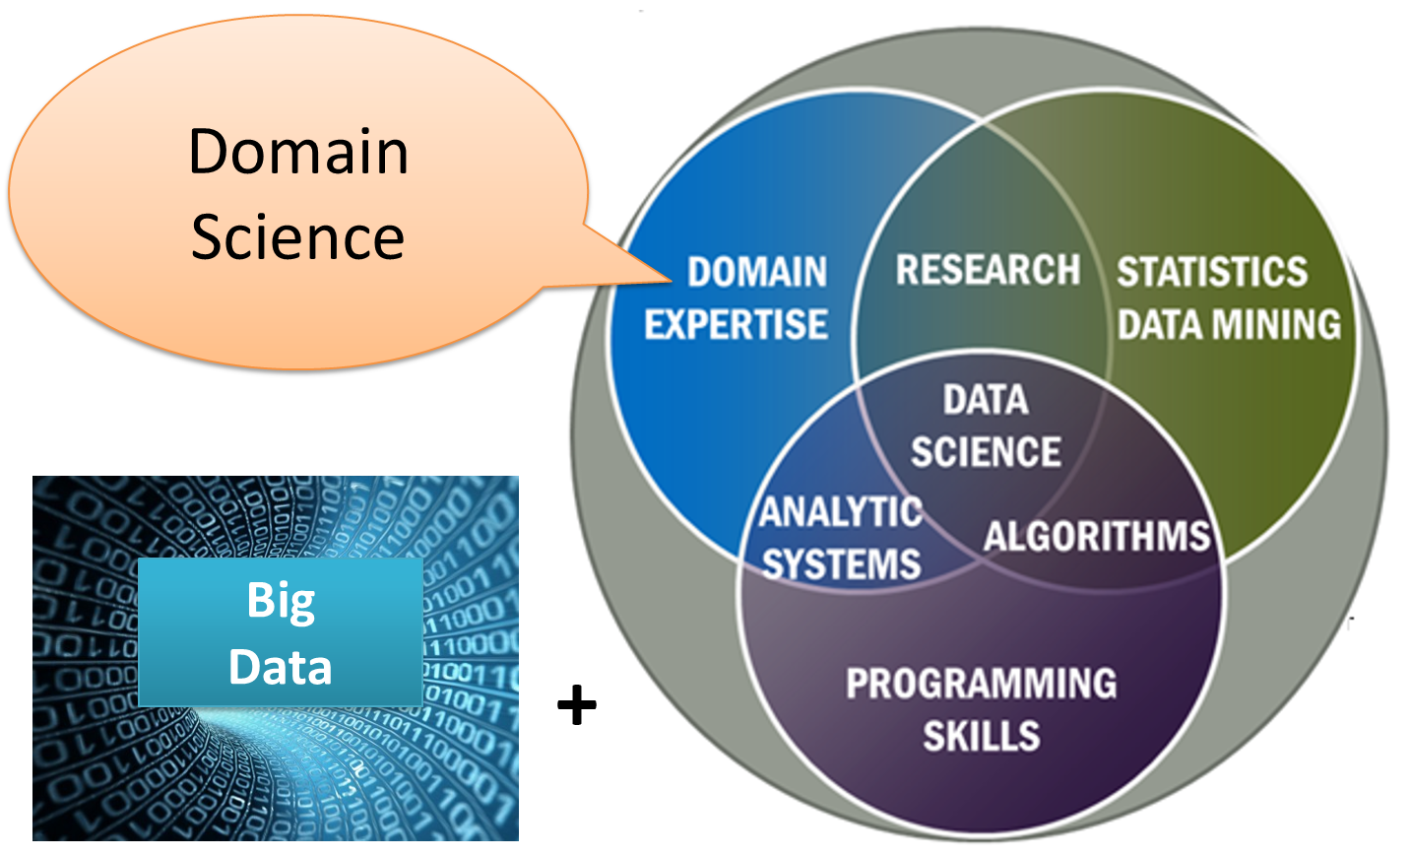
What is data science
Data science is the field of study that combines domain expertise, programming skills, and knowledge of mathematics and statistics to extract meaningful insights from data.

Slide 16
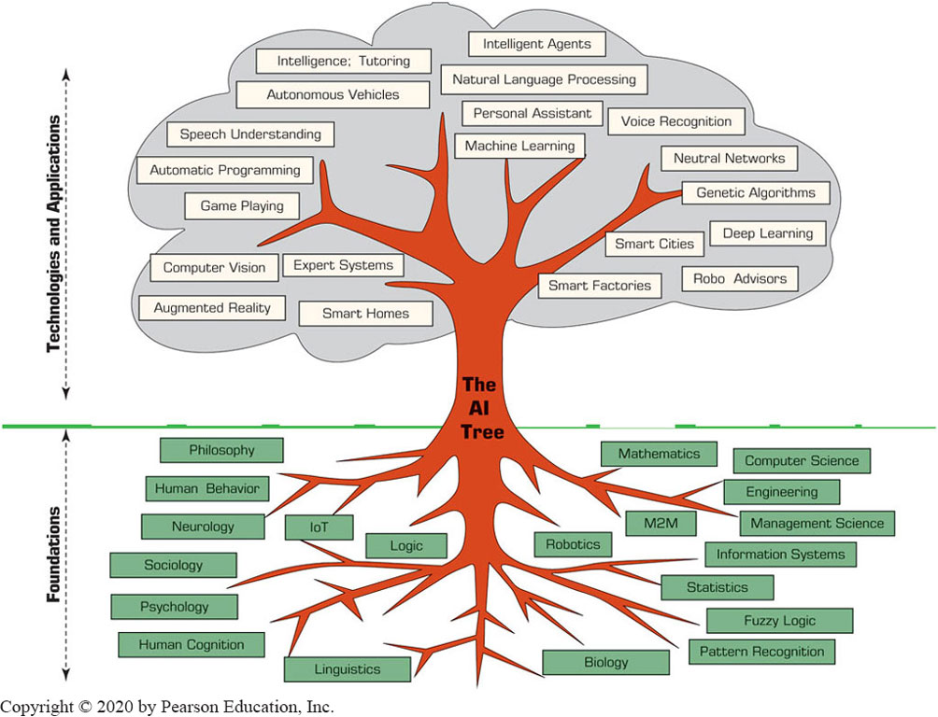
The ai tree

Slide 17
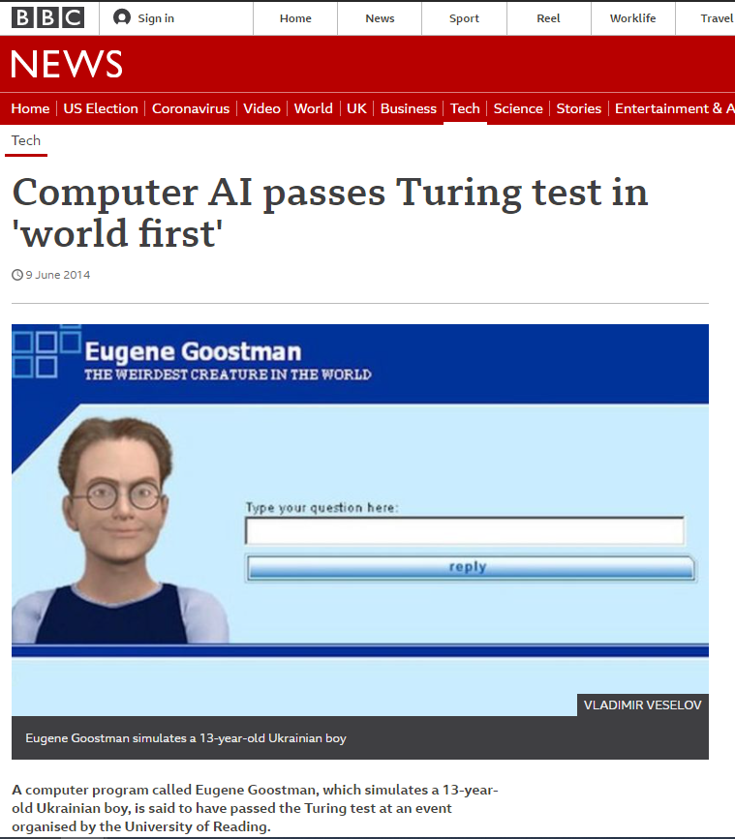
Computer AI passes Turing test in 'world first'
The test investigates whether people can detect if they are talking to machines or humans (BBC, 2014).
https://www.bbc.com/news/technology-27762088
https://www.youtube.com/watch?v=4VROUIAF2Do

Slide 18
Roles of data experts
Data Scientist
Data Analyst
Data Engineer
DATA SCIENTIST
Data scientists examine which questions need
answering and where to find the related data.
They have business acumen and analytical skills as
well as the ability to mine, clean, and present data.
DATA ANALYST
Data analysts bridge the gap between data scientists and business analysts. They are provided with the questions that need answering from an organization and then organize and analyze data to find results that align with high-level business strategy.
DATA ENGINEER
Data engineers manage exponential amounts of rapidly changing data. They focus on the development, deployment, management, and optimization of data pipelines and infrastructure to transform and transfer data to data scientists for querying.

Slide 19
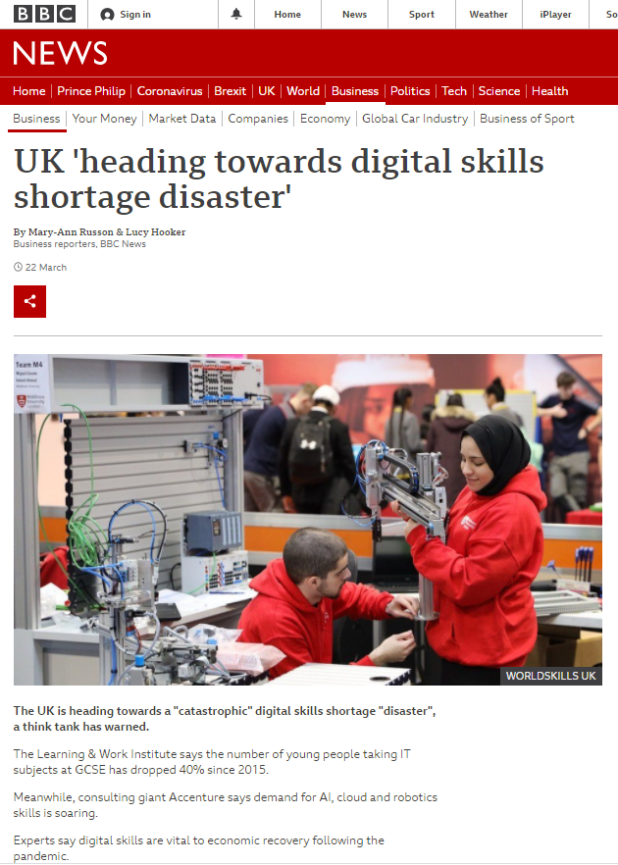
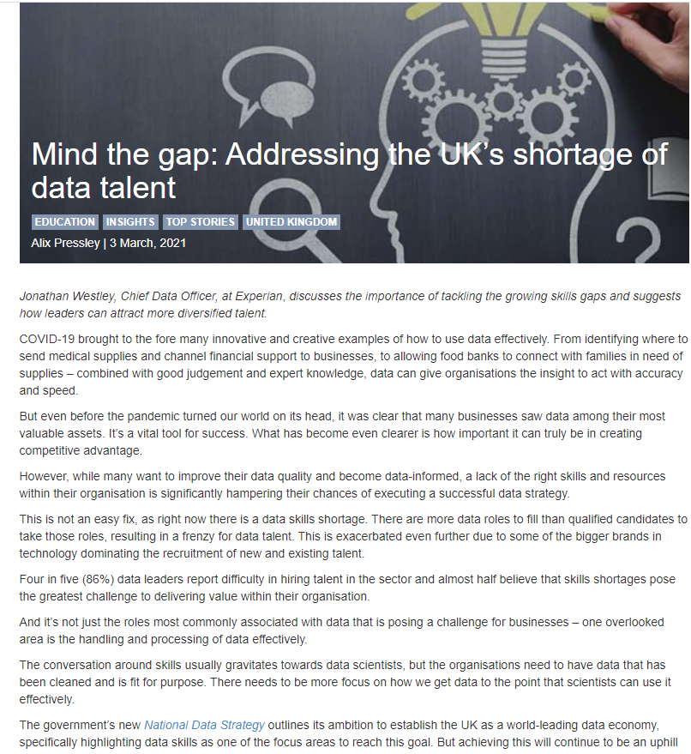
UK’s shortage of data talent

Slide 20
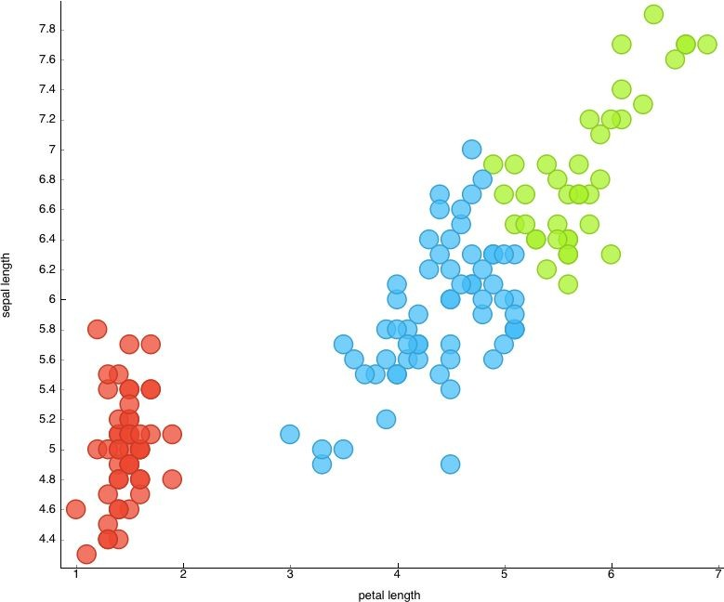


Data Science PROCESS
Data Mining
Data cleaning/ preprocessing
Data
Analysis & interpretation
collection

Slide 21
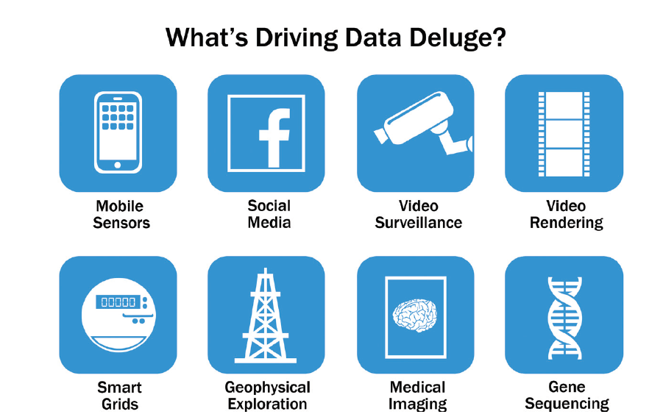
The 5 V’s of big data
The Five V’s of Big Data.
(Big Data Fundamentals: Concepts, Drivers & Techniques, by Wajid Khattak, Paul Buhler, Thomas Erl, 2016)
(Data Science and Big Data Analytics: Discovering, Analyzing, Visualizing and Presenting Data, 2015)

Slide 22
GROUP DISCUSSION (15 – 20 minutes)
Go to your assigned group
Discuss and write about the Five V’s providing examples in each case
Share with your colleagues

Slide 23
The Nature of Data
Data: a collection of facts
usually obtained as the result of experiences, observations, or experiments.
Data may consist of numbers, words, images, etc.
Data is the lowest level of abstraction (from which information and knowledge are derived).
Data is the source for information and knowledge.
Data quality and data integrity → critical to analytics.

Slide 24
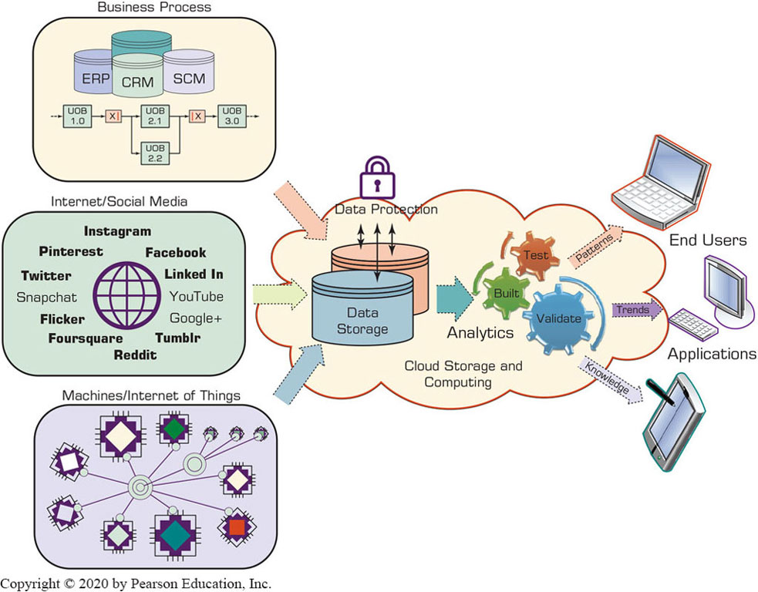
DaTA Processing
https://hackernoon.com/what-steps-should-one-take-while-doing-data-preprocessing-502c993e1caa

Slide 25
A Simple Taxonomy of Data
Data (datum—singular form of data): facts
Structured data
Targeted for computers to process
Numeric versus Nominal
Unstructured/textual data or semi-structured data
Targeted for humans to process
X M L, H T M L, Log files, etc.

Slide 26
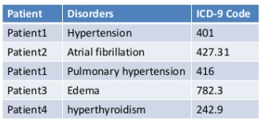
Structured Data
Well organised
Come in table form, with rows and columns
Tables can be connected via relational database schema, making searching easy

Slide 27
Unstructured data
Less organised data
Examples: text, sound, images, videos etc.
No defined relationship between elements of data
Searching and analysing is often complex
Require specialised tools to convert to structured data.

Slide 28
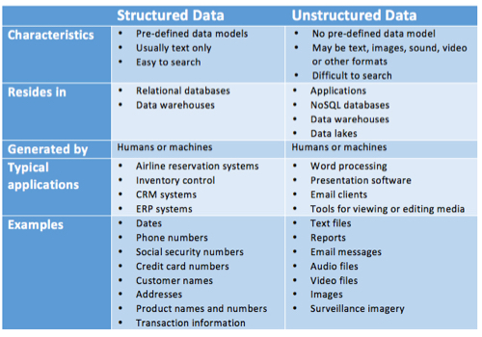
Structured v/s unstructured data

Slide 29
Metrics for Analytics ready Data
Data source reliability
Data content accuracy
Data accessibility
Data security and data privacy
Data richness
Data consistency
Data currency/data timeliness
Data granularity
Data validity and data relevancy

Slide 30
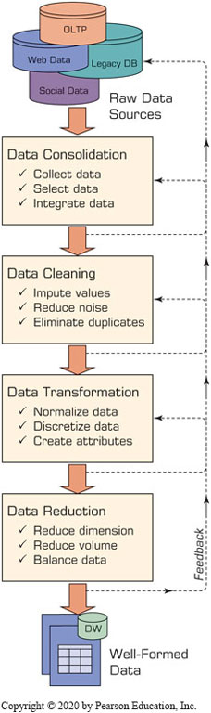
The Art and Science of Data Pre-processing
The real-world data is dirty, misaligned, overly
complex, and inaccurate
Not ready for analytics!
Readying the data for analytics is needed
Data preprocessing
Data consolidation
Data cleaning
Data transformation
Data reduction
Art – it develops and improves with experience

Slide 31
Data Pre-processing Tasks and Methods
A Summary of Data Pre-processing Tasks and Potential Methods.
Main Task | Subtasks | Popular Methods
Data consolidation | Access and collect the data Select and filter the data Integrate and unify the data | SQL queries, software agents, Web services. Domain expertise, SQL queries, statistical tests. SQL queries, domain expertise, ontology-driven data mapping.
Data cleaning | Handle missing values in the data | Fill in missing values (imputations) with most appropriate values (mean, median, min/max, mode, etc.); recode the missing values with a constant such as “ML”; remove the record of the missing value; do nothing.
Blank | Identify and reduce noise in the data | Identify the outliers in data with simple statistical techniques (such as averages and standard deviations) or with cluster analysis; once identified, either remove the outliers or smooth them by using binning, regression, or simple averages.
Blank | Find and eliminate erroneous data | Identify the erroneous values in data (other than outliers), such as odd values, inconsistent class labels, odd distributions; once identified, use domain expertise to correct the values or remove the records holding the erroneous values.
Data transformation | Normalize the data | Reduce the range of values in each numerically valued variable to a standard range (e.g., 0 to 1 or −1 to +1) by using a variety of normalization or scaling techniques.
Blank | Discretize or aggregate the data | If needed, convert the numeric variables into discrete representations using range- or frequency-based binning techniques; for categorical variables, reduce the number of values by applying proper concept hierarchies.
Blank | Construct new attributes | Derive new and more informative variables from the existing ones using a wide range of mathematical functions (as simple as addition and multiplication or as complex as a hybrid combination of log transformations).
Data reduction | Reduce number of attributes | Use principal component analysis, independent component analysis, chi-square testing, correlation analysis, and decision tree induction.
Blank | Reduce number of records | Perform random sampling, stratified sampling, expert-knowledge-driven purposeful sampling.
Blank | Balance skewed data | Oversample the less represented or undersample the more represented classes.

Slide 32
ASSESSMEnT BRIEF & Weekly ACTIVITIES

Slide 33
Group Discussion 20 min Types of analysis
Discuss the 5 different analysis below by providing examples.
Exploratory data analysis
Causal analysis
Predictive analysis
Prescriptive analysis
Inferential analysis

Slide 34
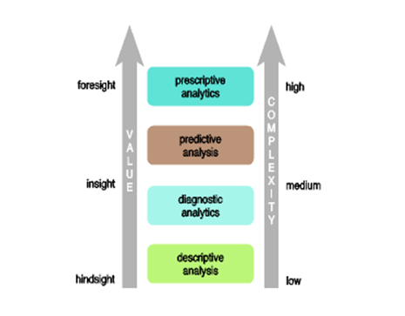

Data that has high veracity and can be analyzed quickly has more value to a business.

Slide 35
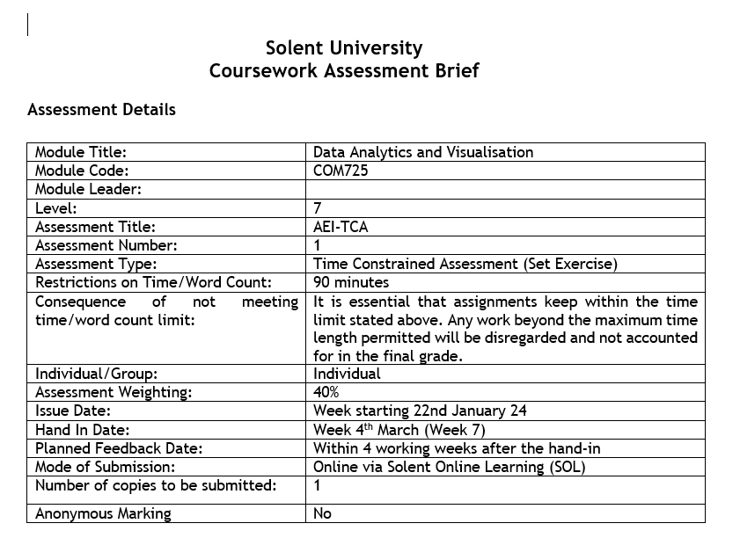
AE1

Slide 36
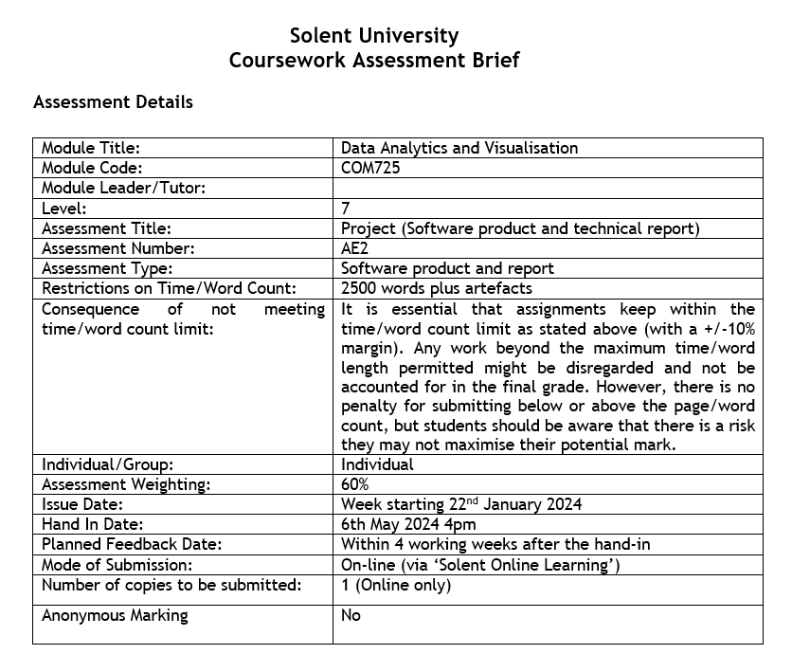
AE2

Slide 37
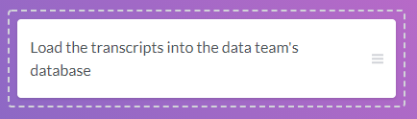
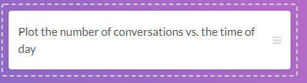

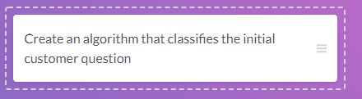


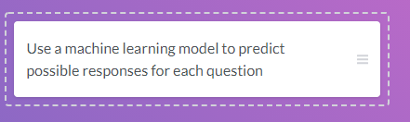
ACTIVITY 1
Building a customer service chatbot
Ritesh and his data team are working on a customer service chatbot. The chatbot is a computer program that uses data science to answer basic customer questions via a messenger. The team will use transcripts from over 300,000 customer service interactions to train a chatbot to answer customer questions.
Place each action that Ritesh's team will take in the appropriate step of the data science workflow.

Slide 38
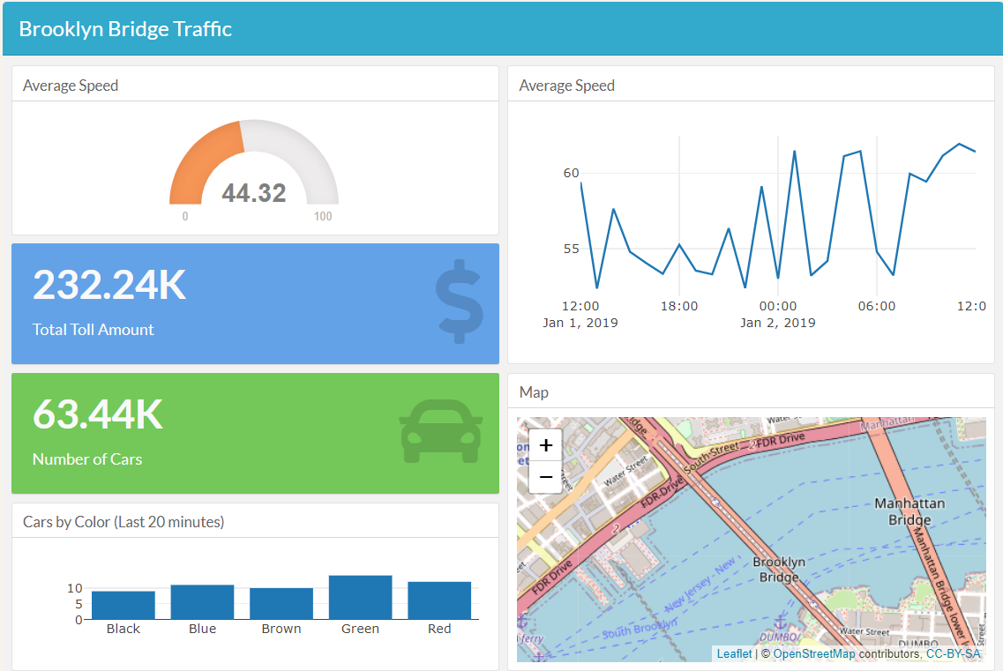
Activity 2
Improving a dashboard
This is the dashboard of data collected by vibration sensors on the Brooklyn Bridge to measure the amount of traffic. Take a closer look at this dashboard and see if you can come up with some suggestions to improve it. Which suggestion would you not give?
A. The bars in the "Cars by Color" graph should match the car colors they represent.
B.MPH (miles per hours) should be added to the title and axis labels referring to average speed.
C. The "Total Toll Amount" and "Number of Cars" components need a date associated with them.
D. The y-axis in the top right "Average Speed" graph needs to start at 0, as opposed to 52.

Slide 39
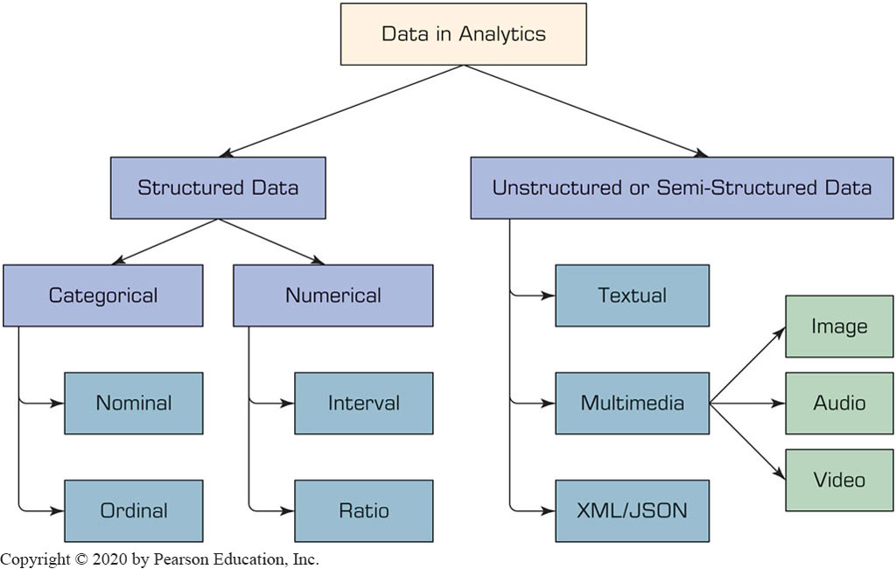
Activity 3 A Simple Taxonomy of Data
Differentiate between nominal, ordinal, interval and ratio data by providing some examples.

Slide 40
ACTIVITY 4 (30-45 min) and NEXT WEEK
This activity will help you in identifying a dataset that contain some medical information that you wish to use for AE2 assignment. Please explore some of the sources of open datasets:
Google Dataset search
Data.gov.uk
WHO
Dataverse
Office for National Statistics
DECIDE WHICH DATASETS YOU WILL BE USING BY WEEK 3 AFTER MAKING SOME RESEARCH.

Slide 41
Resources
Books:
Essential Reading:
Madsen, Laura B. Data-Driven healthcare: how analytics and BI are transforming the industry, John Wiley & Sons, 2014.
Marz, Nathan, and James Warren. Big Data: Principles and best practices of scalable real-time data systems. New York; Manning Publications Co., 2015.
Recommended reading:
Kabacoff, R. "R in Action: Data Analysis and Graphics with R" (2015).
Zumel, Nina, and John Mount. Practical data science with R. Manning Publications Co., 2014.
I may provide an additional reading list at the end of each lecture.
The university subscribes to LinkedIn Learning, which offers a range of online video tutorials that are freely available to all students and staff.

